Slide 1
1) Overview
This package includes some modules which can configure system options and some useful knowledge bases.

Slide 2
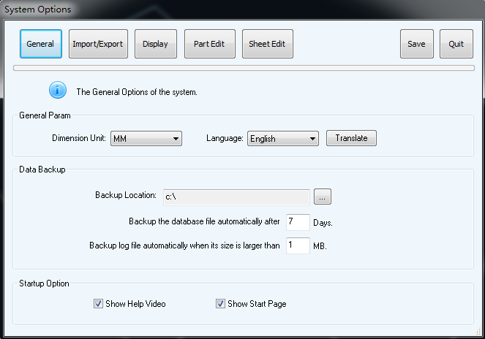
2) clOption module
The clOption module is system option module of COE, it provides many settings of CutLeader, e.g. the display color of the geometry, options of importing dxf/dwg, the simulation speed of cut sequence, etc. Please refer to the figure below.

Slide 3
2.1) UML diagram
This UML diagram illustrates the data architecture of clOption module.
ProductParam
PartEditParam
DisplayParam
CLOptionInfo
SheetEditParam
ImpExpConfig
ConcealConfig
DebugUIInfo
SimulateInfo

Slide 4
2.2) class details
Data structures for CLOptionInfo
Class name | Description
CLOptionInfo | All options for COE.
ProductParam | The basic options for COE.
DisplayParam | The display options for COE.
ImpExpConfig | The options for importing and exporting data.
PartEditParam | The options for part editing.
SheetEditParam | The options for sheet editing.

Slide 5
Class name | Description
ConcealConfig | Options which are concealed and used for debug.
DebugUIInfo | Some concealed options which can hide/show some dialogs.
SimulateInfo | Some concealed options which can control the display size of some COE objects.
Other classes
Class name | Description
CLOptionLoader | This class can load COE options from xml configuration file.
CLOptionWriter | This class can save COE options to xml configuration file.

Slide 6
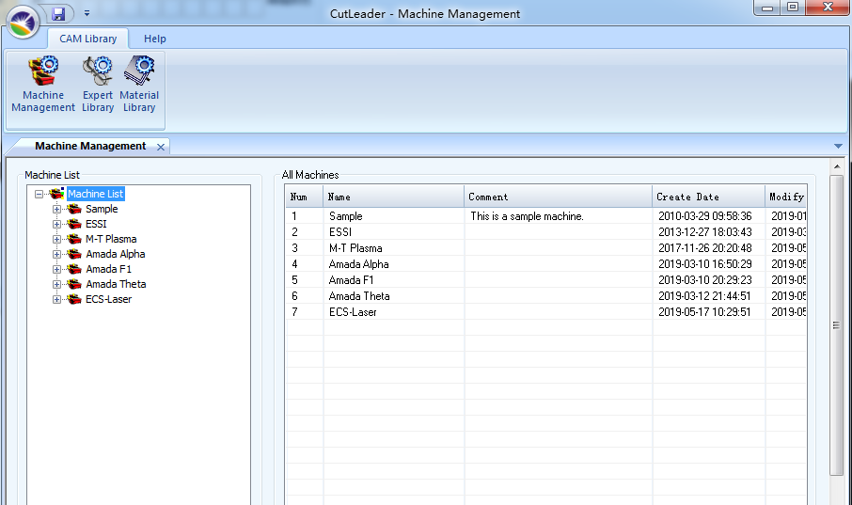
3) clMachineLib module
The clMachineLib module is machine library module of COE, it provides the machine management abilities, e.g. define the params and the drivers of machines, database management of machines, etc.

Slide 7
3.1) UML diagram
This UML diagram illustrates the data architecture of clMachineLib module.
ConditionTypeList
MachineItem
NCConfigTypeList
MachineParam
MachineTable
OverTravel
DriverData

Slide 8
3.2) class details
Data structures for MachineItem
Class name | Description
MachineItem | This class represents a machine.
NCConfigTypeList | The NC code configuration for the machine.
ConditionTypeList | The cut condition configuration for the machine.
MachineParam | The parameters of machine.
MachineTable | The table info of machine.
OverTravel | The over travel info of machine.
DriverData | Driver info of machine, used to generate NC code.

Slide 9
Other classes
Class name | Description
MachineItemLoader | This class can load machine data from COE database.
MachineItemWriter | This class can save machine data to COE database.

Slide 10
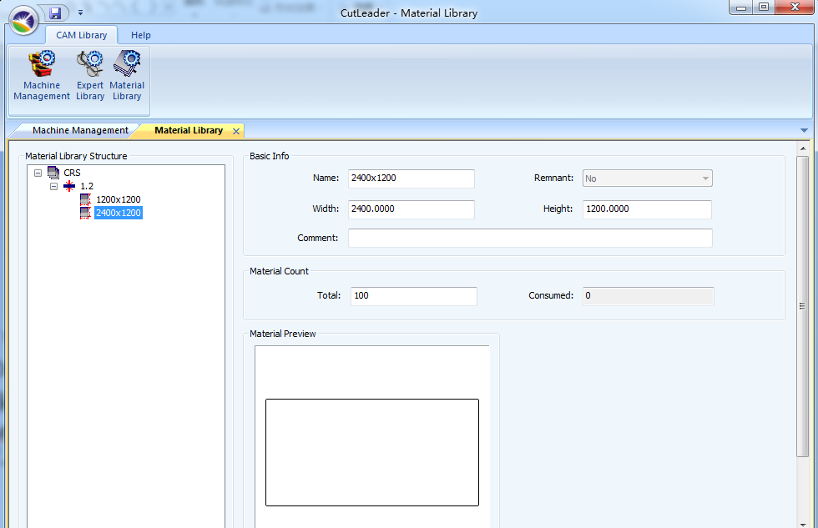
4) clMaterialLib module
The clMaterialLib module is material library module of COE, material library stored many materials with different size and thickness which can be used to create sheet.
COE

Slide 11
4.1) UML diagram
This UML diagram illustrates the data architecture of clMaterialLib module.
MaterialList
Material
MaterialThickness
IMaterialSize
RectMaterial
PolygonMaterial

Slide 12
4.2) class details
Data structures for Material
Class name | Description
Material MaterialList | A material object is a kind of material which consists some thicknesses.
MaterialThickness MaterialThicknessList | MaterialThickness object consist some IMaterialSize object.
IMaterialSize MaterialSizeBase MaterialSizeList | Material size object can be used to create sheet.
RectMaterial | The material size object with the rectangle shape.
PolygonMaterial | The material size object with the polygon shape.

Slide 13
Other classes
Class name | Description
MaterialLibLoader | This class can load material data from COE database.
MaterialLibWriter | This class can save material data to COE database.
MaterialProcessor | The processor for material.

Slide 14
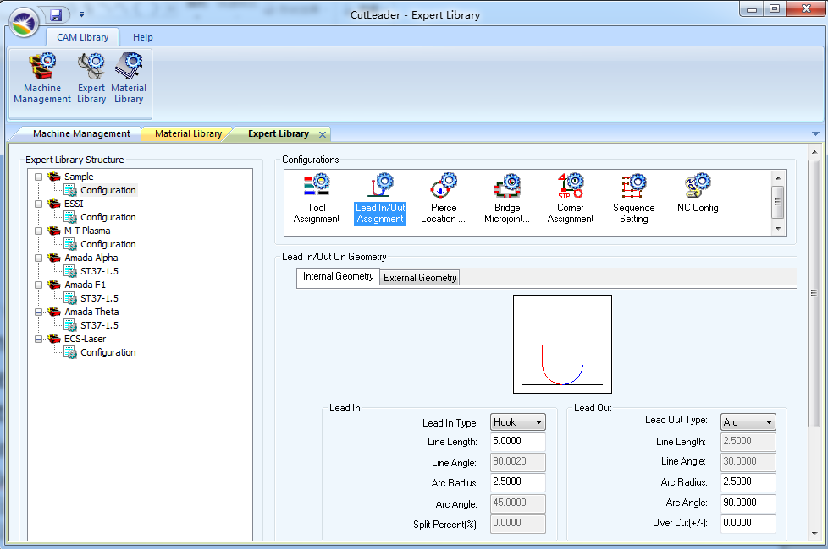
5) clExpertLib module
The clExpertLib module is expert library module of COE, like its name, expert library stored many experiences and rules of experts about cut feature assignment, cut sequence assignment, nesting, etc. User can reuse and modify these experiences during their work.

Slide 15
5.1) UML diagram of expert library
This UML diagram illustrates the data architecture of clExpertlLib module.
ExpertLibItem
MachineItem
ParamConfig
CornerConfigItem
ParamConfigItem
NestConfigItem
LeadConfigItem
PierceConfigItem
NCConfigItem
SequenceConfigItem
MicroJointConfigItem
ToolAssignConfigItem

Slide 16
5.2) expert library item
An expert library item contains all expert experiences about cut feature assignment, sequence generation, etc. One machine is only corresponding to one expert library item.
Class name | Description
ExpertLibItem | The expert library item object.
ParamConfig ParamConfigList | An expert library item object can contain several param config objects.
ParamConfigItem ParamConfigItemList | The param config item, such as tool assignment config item, lead config item, etc.

Slide 17
5.3) tool assignment rule
COE can use tool assignment rule to assign tools for pattern loop.
Class name | Description
ToolAssignConfigItem | The tool assignment rule.
ToolInstance ToolInstanceList | Tool instance.
ToolAssignRule ToolAssignRuleList | Tool assignment rule for specified loop.
DxfLayerToolMap | The map between layer/color and tool after importing patterns from dxf/dwg.
CondValInfo CondValInfoList | The condition values for tool instance.

Slide 18
5.4) lead in/out assignment rule
COE can use lead assignment rule to assign lead in/out data for pattern loop.
Class name | Description
LeadConfigItem | The lead in/out assignment rule.
LeadInOutData | Lead in/out data of the rule.

Slide 19
5.5) pierce location rule
COE can use pierce location rule to decide where pattern loop will be pierced.
Class name | Description
PierceConfigItem | The pierce location rule.
PierceLocationInfo | Pierce location data of the rule.

Slide 20
5.6) micro joint assignment rule
COE can use micro joint assignment rule to assign micro joints for pattern loop.
Class name | Description
MicroJointConfigItem | Micro joint assignment rule.
MicroJointRange MicroJointRangeInfo | Micro joint assignment data for a range.

Slide 21
5.7) corner feature assignment rule
COE can use corner feature assignment rule to assign corner features for pattern loop.
Class name | Description
CornerConfigItem | Corner feature assignment rule.
CornerRangeInfo | Corner feature assignment data for a corner range.

Slide 22
5.8) cut sequence generation rule
COE can use sequence generation rule to generate cut sequences automatically.
Class name | Description
SequenceConfigItem | Cut sequence generation rule.
BridgeCutParam | Generation rules for bridge cut sequence.
ChainCutParam | Generation rules for chain cut sequence.
CollisionAvoidParam | Rules for avoiding sequence collision.
ComCutParam | Generation rules for common cut sequence.
FlyCutParam | Generation rules for fly cut sequence.
GridCutParam | Generation rules for grid cut sequence.

Slide 23
5.9) NC code generation rule
COE can use NC code generation rule to generate NC code for different machine.
Class name | Description
NCConfigItem | NC code generation rule.
NCConfigValue NCConfigValueList | A NC config value of rule.

Slide 24
5.10) nesting rule
COE can use nesting rule to layout parts on sheet to maximize the material utilization.
Class name | Description
NestConfigItem | The parameters for auto nesting.

